Slide 1
Working with SDRs
Group Name: team_bug
Group Members:
Pranil Ghadi (1441215)
Yatish Sharma (1457597)

Slide 2
What is SDR?
Binary representations of data.
Only few bits are active.
Each bit has Meaning

Slide 3
How to Represent SDR
Indices
BitMaps

Slide 4
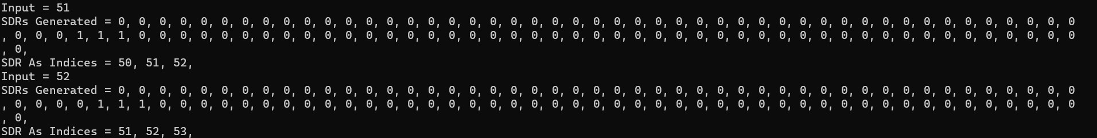
Indices
Returns index number.
Function: NeoCortexApi.Helpers.StringifyVector

Slide 5
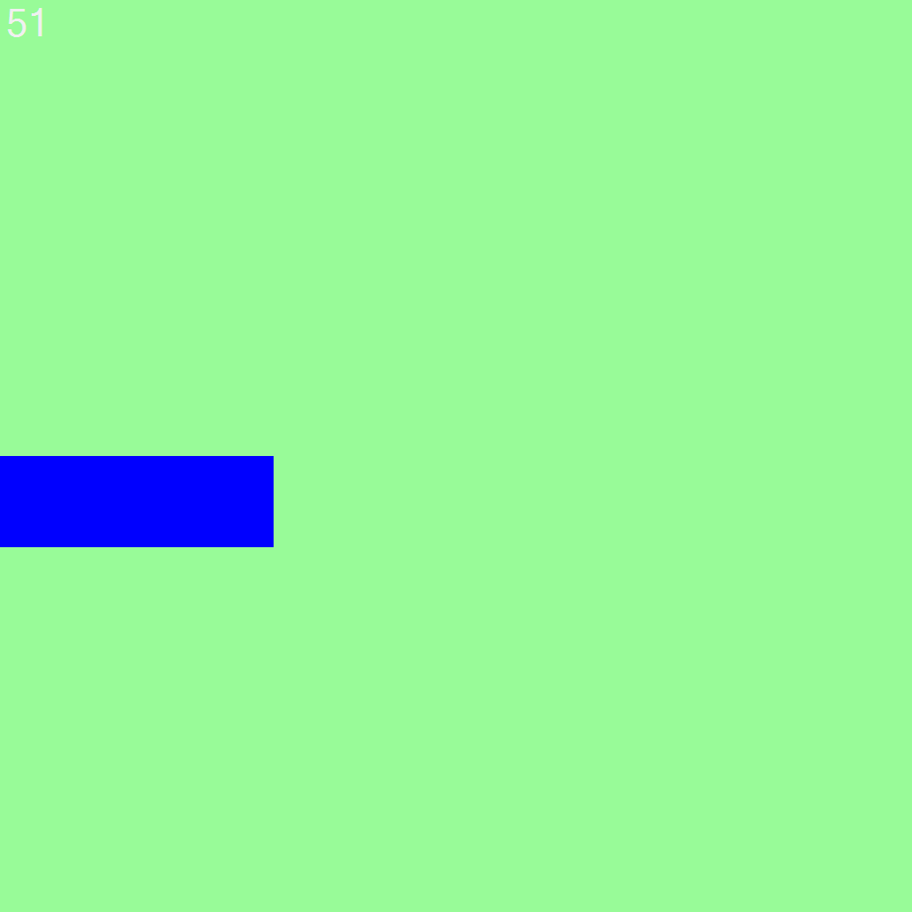

BitMaps
Used to store images.
Function: NeoCortexUtils.DrawBitmap()
SDR of 51
SDR of 52

Slide 6
SDR Analysis
Similarity
Overlap
Union
Intersection

Slide 7
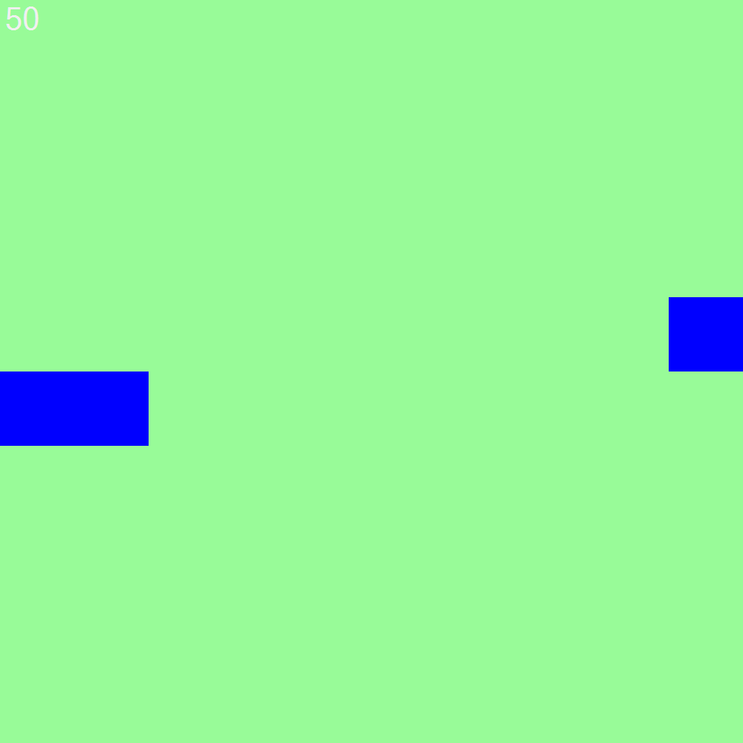
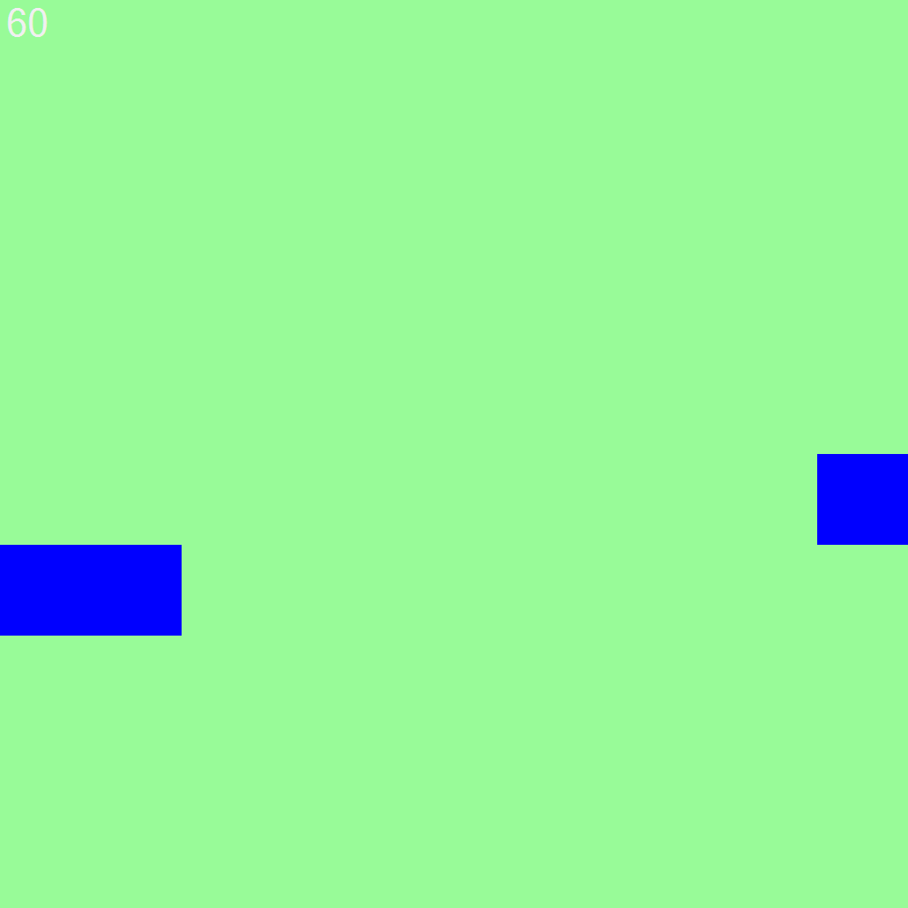
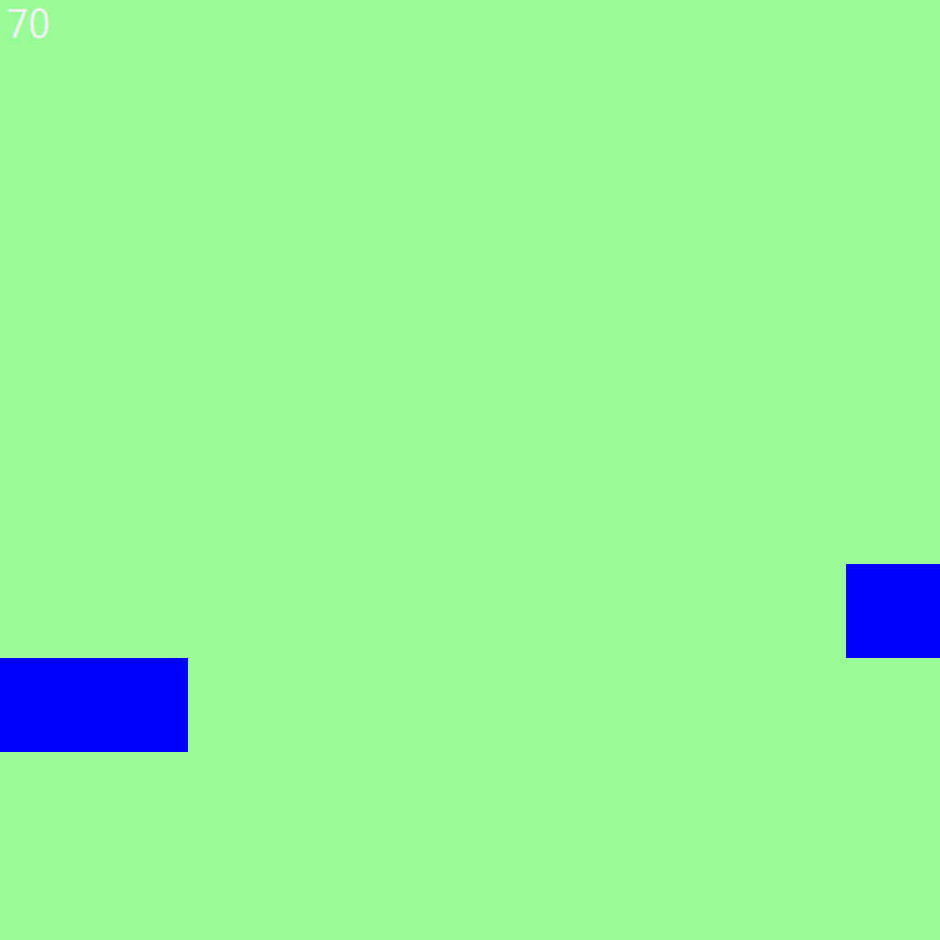
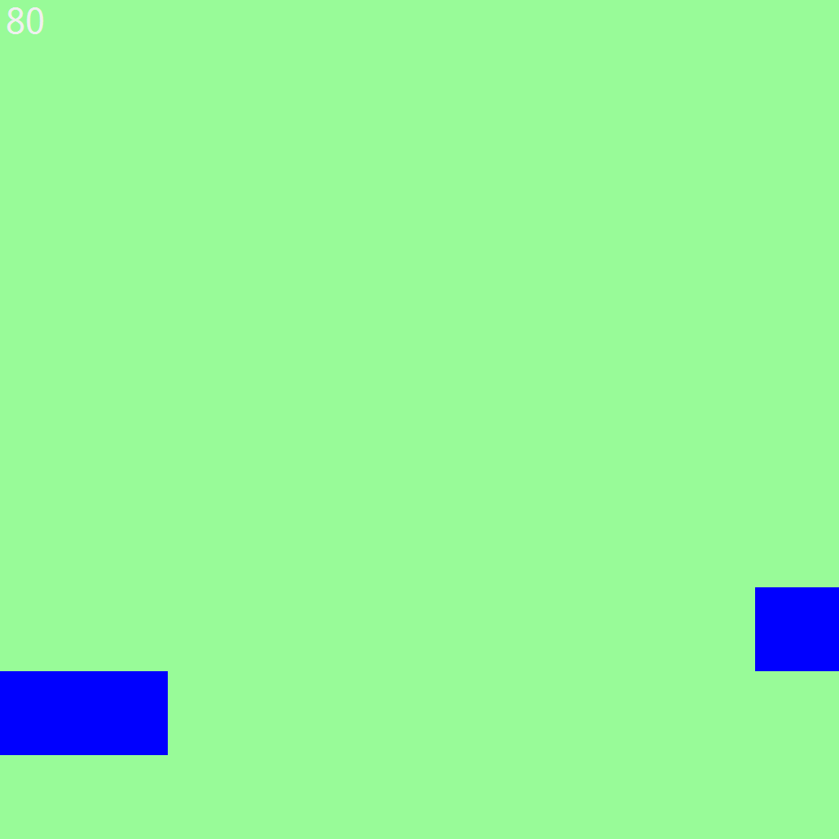
Similarity
SDR of 50 SDR of 60 SDR of 70 SDR of 80

Slide 8
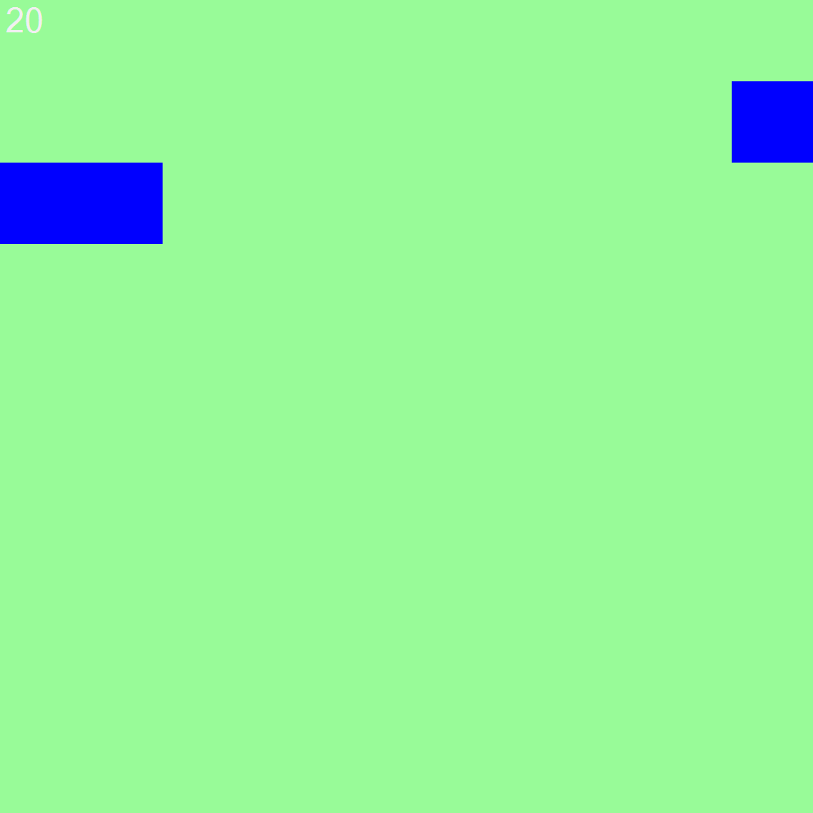


Overlap
SDR of 20
SDR of 21
Overlap of 20-21

Slide 9
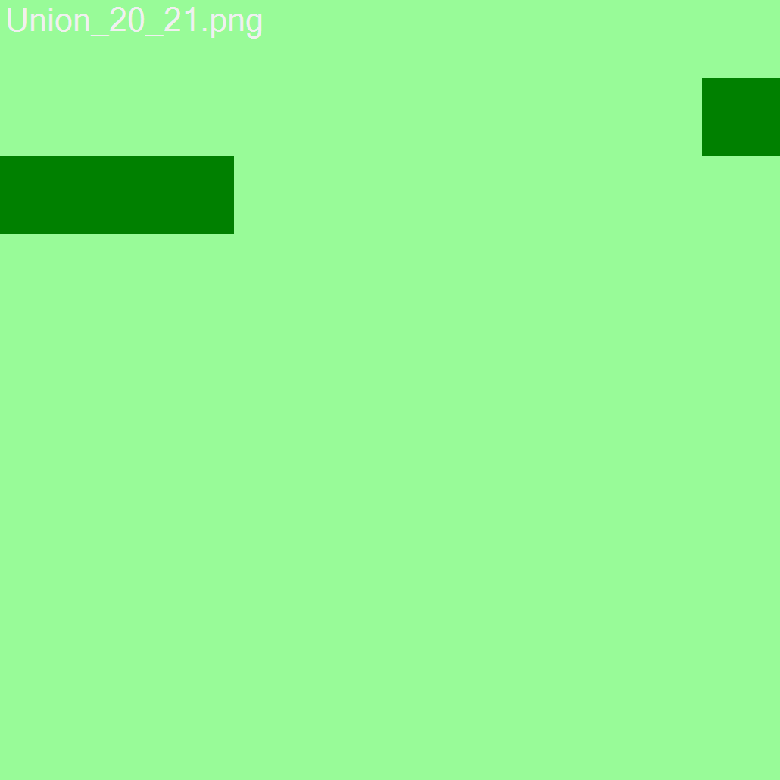
Union
SDR of 20
SDR of 21
Union 20-21

Slide 10
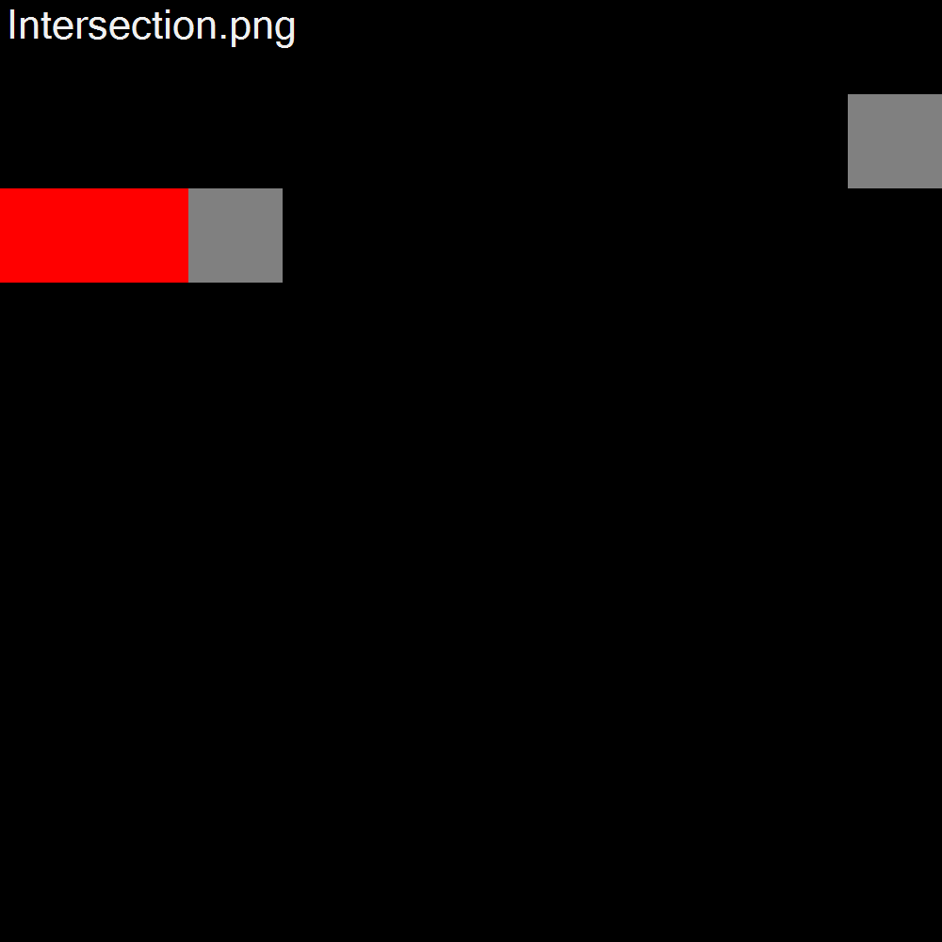
Intersection
Overlap of 20-21
Union of 20-21
Intersection of Overlap and Union

Slide 11
THANK YOU !

